Slide 1
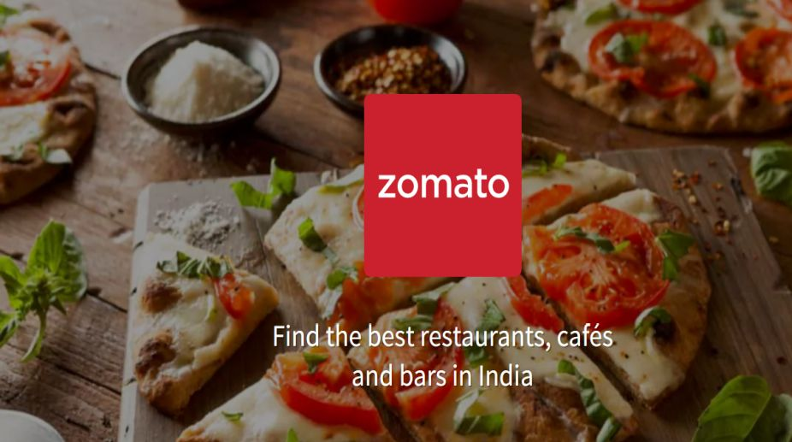
ZOMATO DATA ANALYSIS

Slide 2
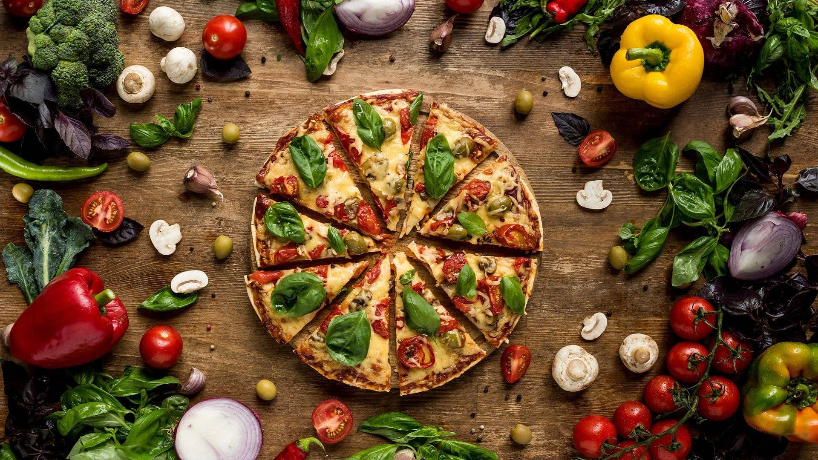
What is Zomato?
Zomato is a food delivery and restaurant discovery app that helps users find nearby restaurants, read reviews, and order food online. It connects customers, restaurants, and delivery partners to make food ordering fast, easy, and reliable.
Understanding about Zomato

Slide 3
Understanding abut Zomato
What is Zomato?
Zomato is a food delivery and restaurant discovery app that helps users find nearby restaurants, read reviews, and order food online. It connects customers, restaurants, and delivery partners to make food ordering fast, easy, and reliable.

Slide 4
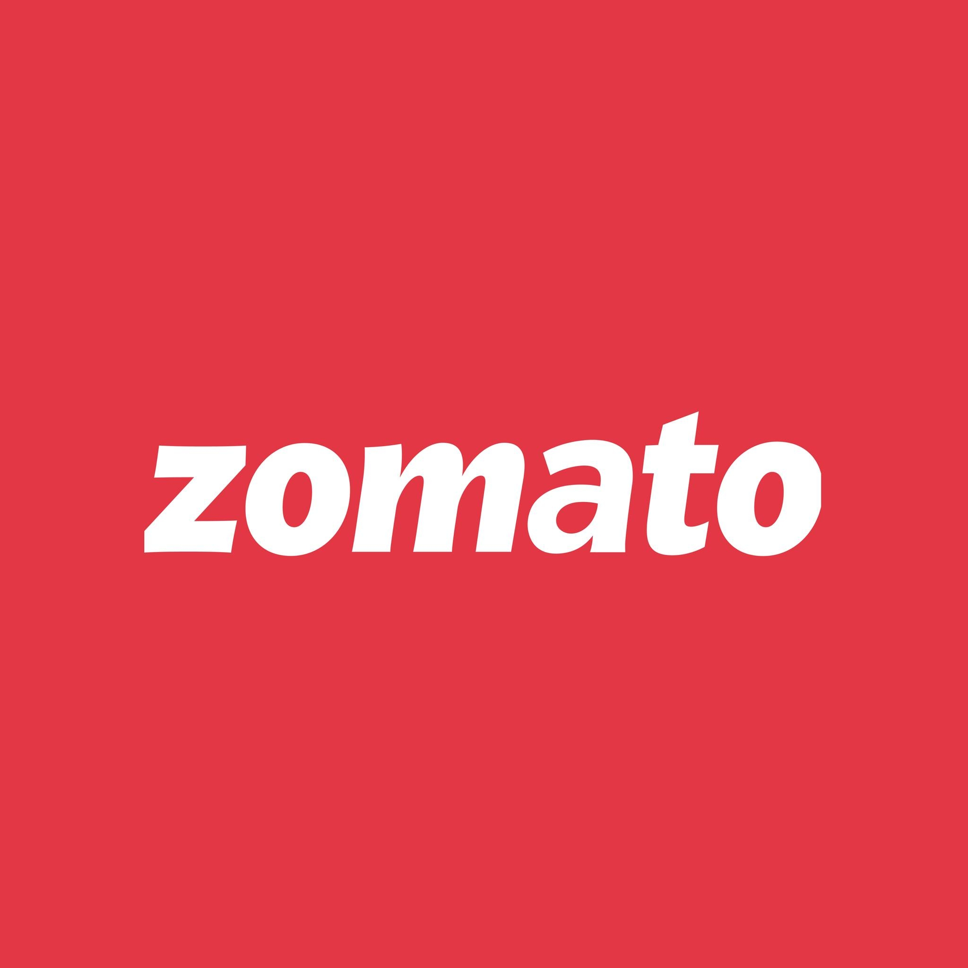
History of Zomato
Founded in 2008 by Deepinder Goyal and Pankaj Chaddah as Foodiebay.
Renamed Zomato in 2010.
Initially started as a restaurant directory, listing menus and reviews.
Expanded rapidly across India and internationally.
Introduced online food ordering and delivery services over time.
Continues to grow with services like Zomato Pro, contactless dining, and cloud kitchens.

Slide 5
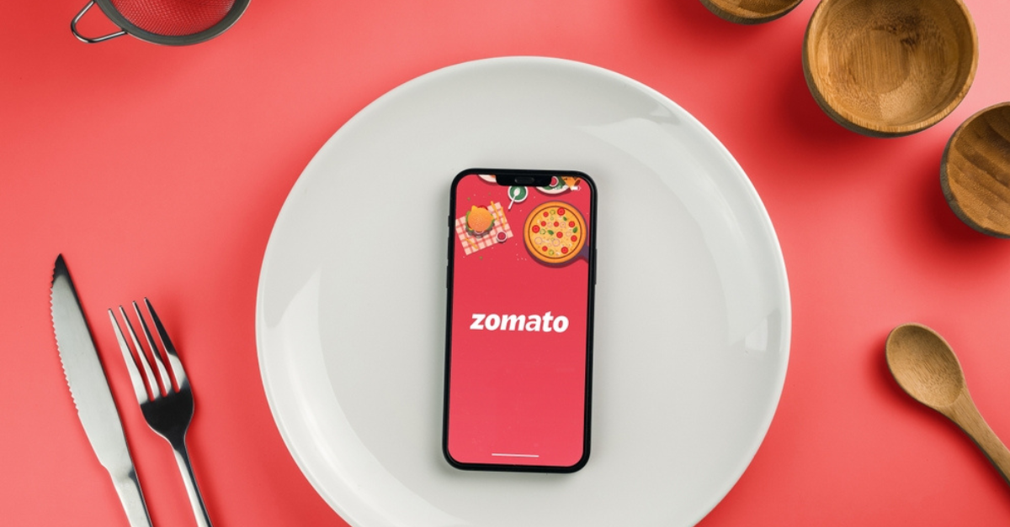

Slide 7
Objective & Scope
Objectives:
To visualize Zomato’s data using Power BI

Slide 8
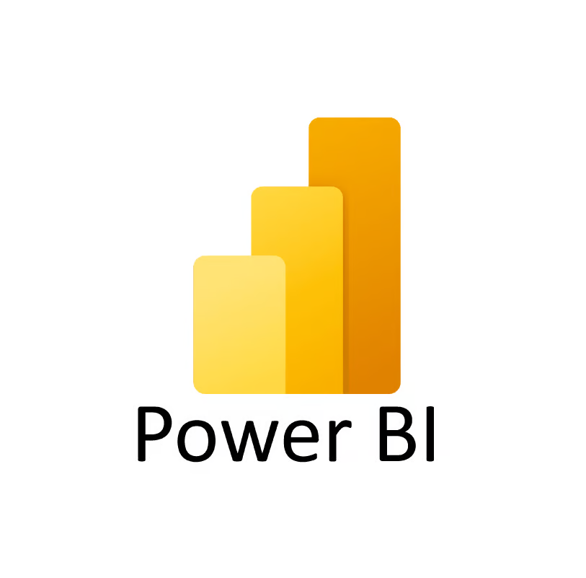
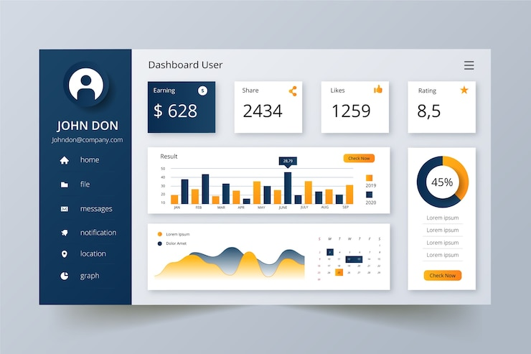
Objective & Scope
Objectives:
To visualize Zomato’s data using Power BI

Slide 9
Objective & Scope
Objectives:
To visualize Zomato’s data using Power BI

Slide 10
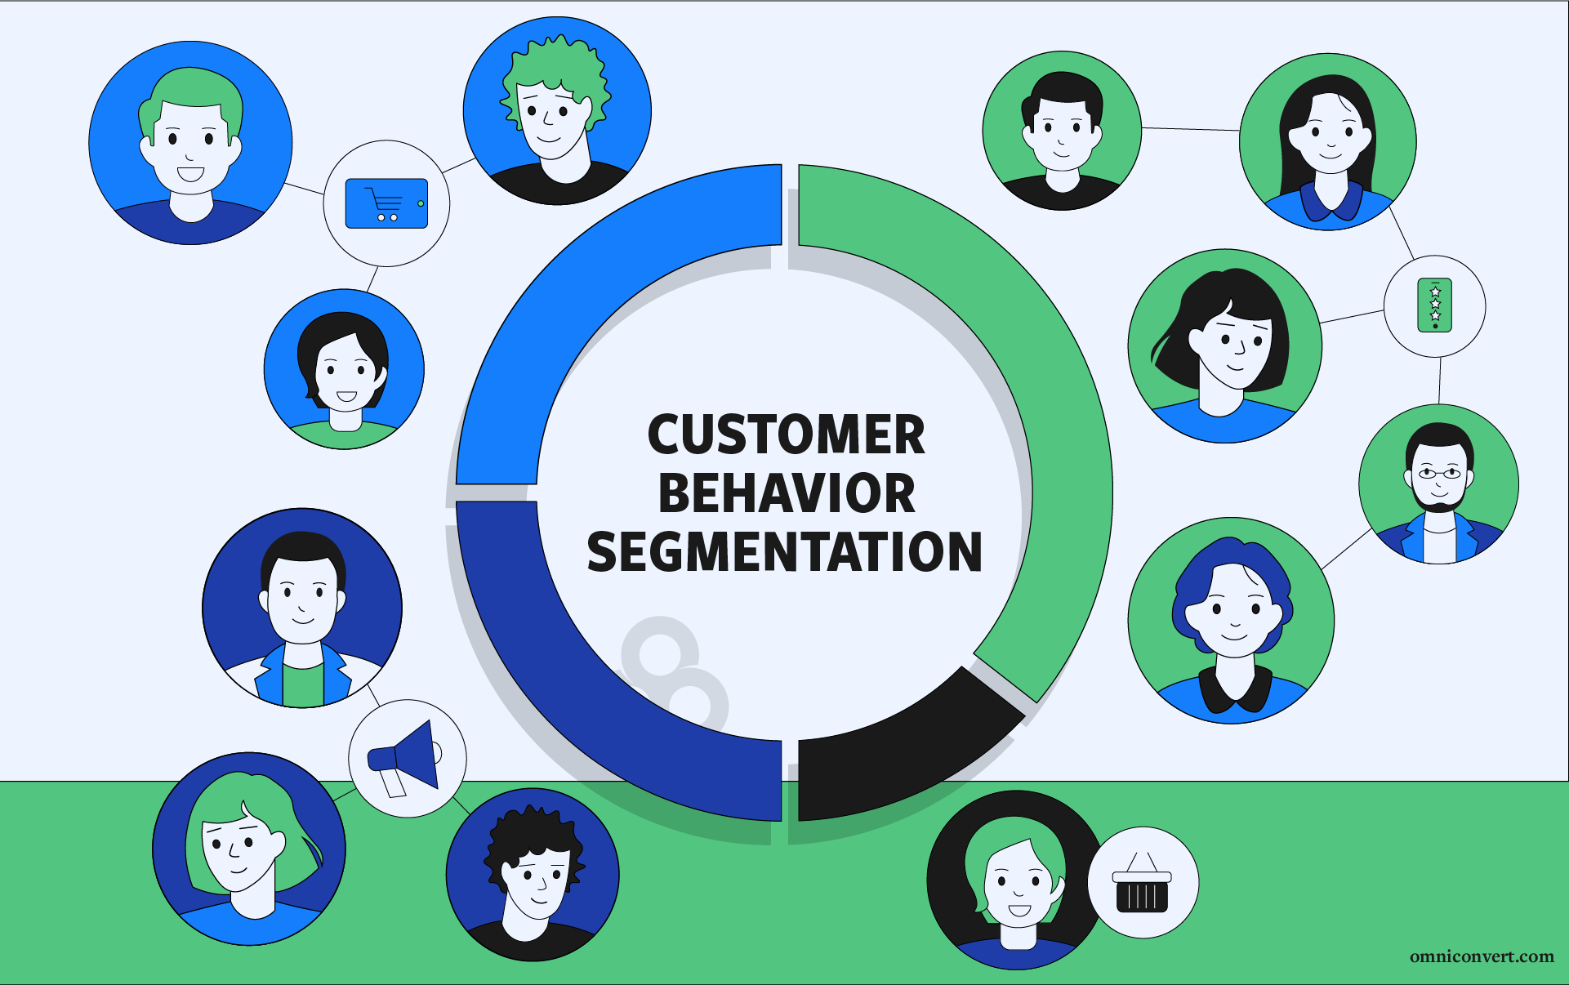
Objective & Scope
Objectives:
To visualize Zomato’s data using Power BI
To derive meaningful insights related to orders, customers, and restaurants
To provide data-driven suggestions to improve user experience

Slide 11
Objective & Scope
Objectives:
To visualize Zomato’s data using Power BI
To derive meaningful insights related to orders, customers, and restaurants
To provide data-driven suggestions to improve user experience
Scope:
Covers order data, customer ratings, delivery times, restaurant popularity, etc.

Slide 12
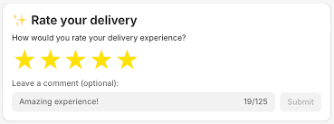
Scope:
Covers order data, customer ratings, delivery times, restaurant popularity, etc.

Slide 13
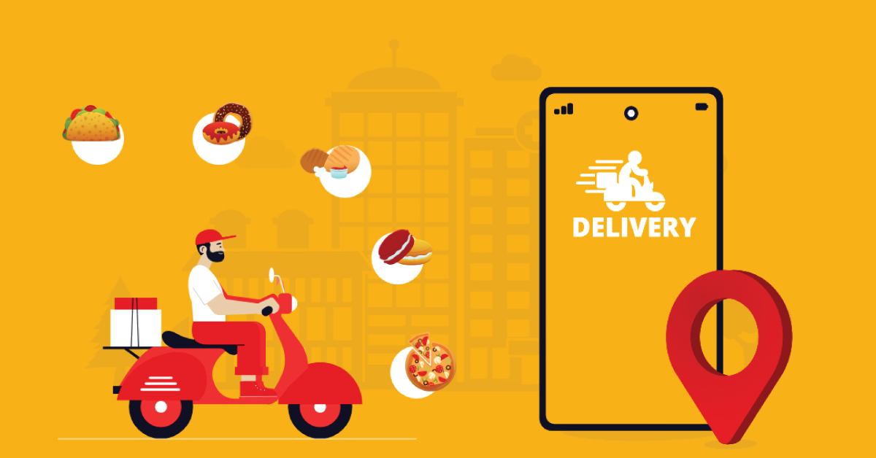
Scope:
Covers order data, customer ratings, delivery times, restaurant popularity, etc.

Slide 14
